Slide 1
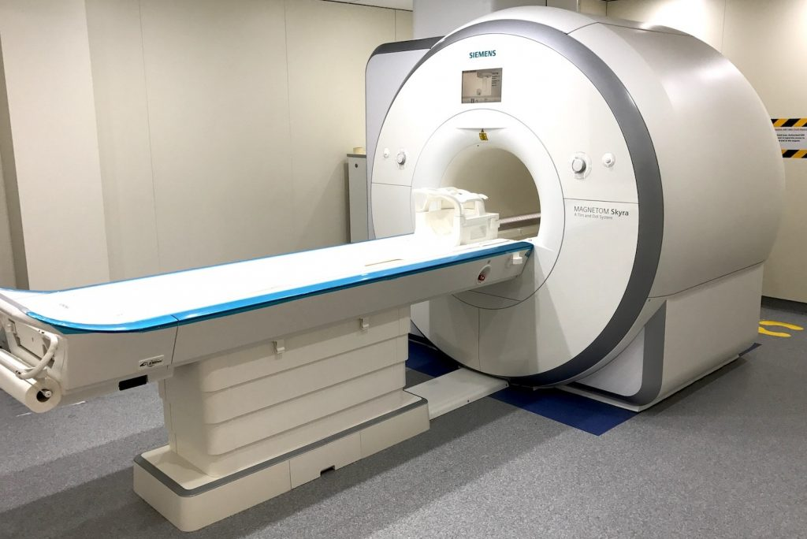

UNIVERSITÀ DEGLI STUDI DI SALERNO
DIPARTIMENTO DI MEDICINA, CHIRURGIA E ODONTOIATRIA,
SCUOLA MEDICA SALERNITANA
Functional MRI Study of Human Gustatory Cortex: Technological Advancements and Applications to Basic and Clinical Neurosciences
Relatore: Candidato:
Ch.mo Prof. Fabrizio Esposito Canna Antonietta
Matr. 8800900011

Slide 2


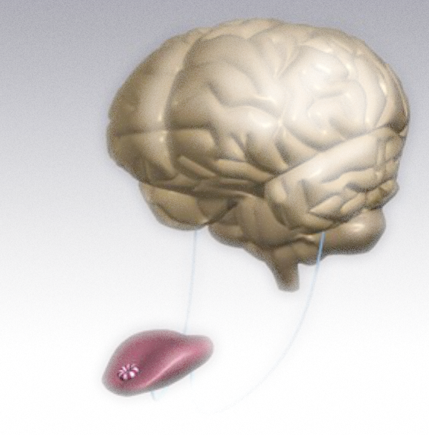
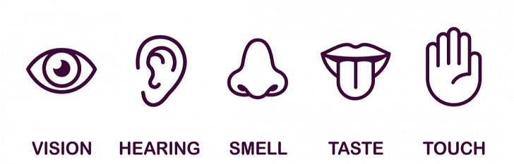
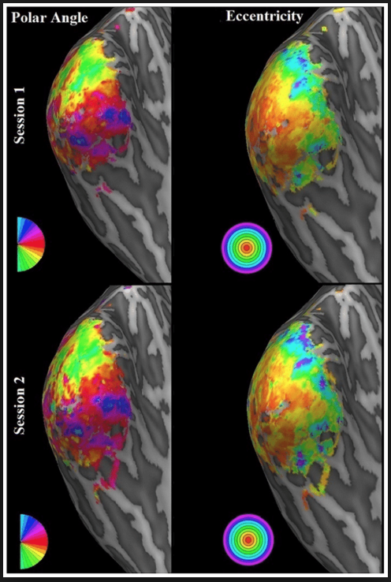
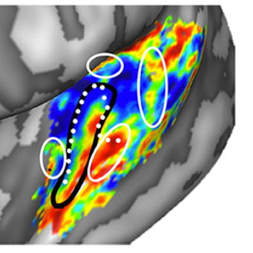

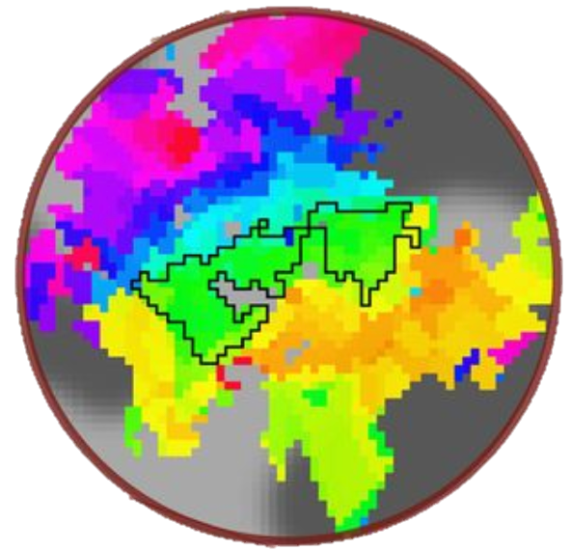
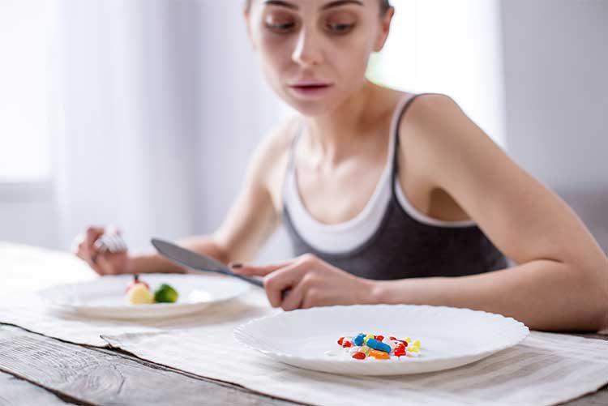
The sense of Taste
Gustotopic maps are not well-defined
Retinotopic maps
Tonotopic maps
Senden et al (2014) PlosOne
Moerel et al (2014) Front Neurosci
Somatotopic maps
Sanchez-Panchuelo et al (2012) J Neurosci
v

Slide 3
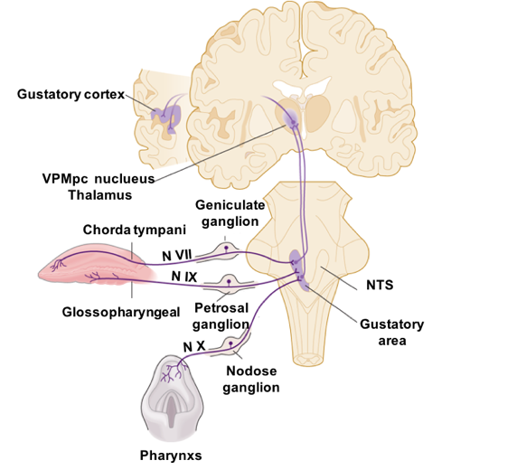
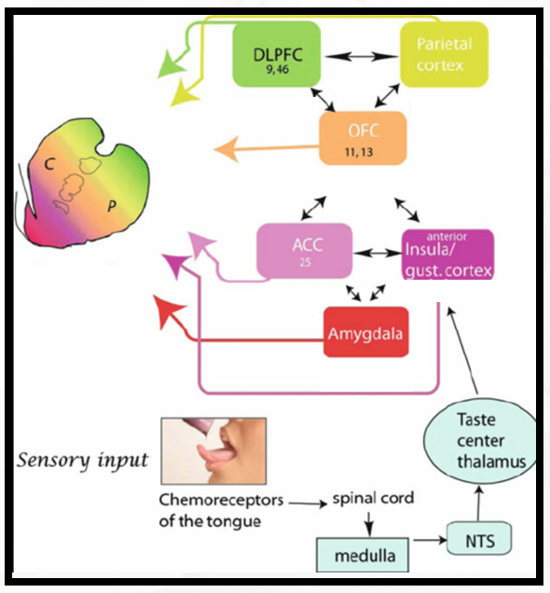
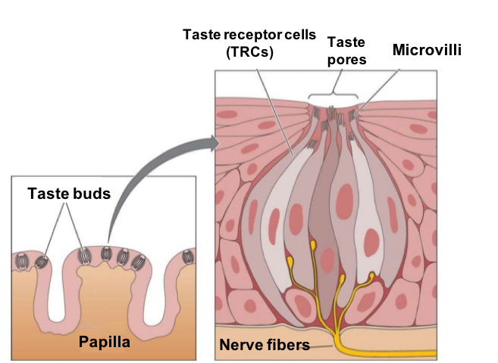
State of the Art: The perception of Taste in Human
Taste pathway in humans and decoding of gustatory stimuli
Decoding of gustatory stimulus in the primary gustatory cortex:
From the tongue to the cerebral cortex
Sweet
Bitter
Sour
Salty
Umami
Cortical-striatal taste pathway
Quality
Intensity
Concentration or taste: molarity (e.g. quantity of taste per solution unit)
Valence
Pleasantness or unpleasantness
Small et al (2010) Brain Structure and Function

Slide 4
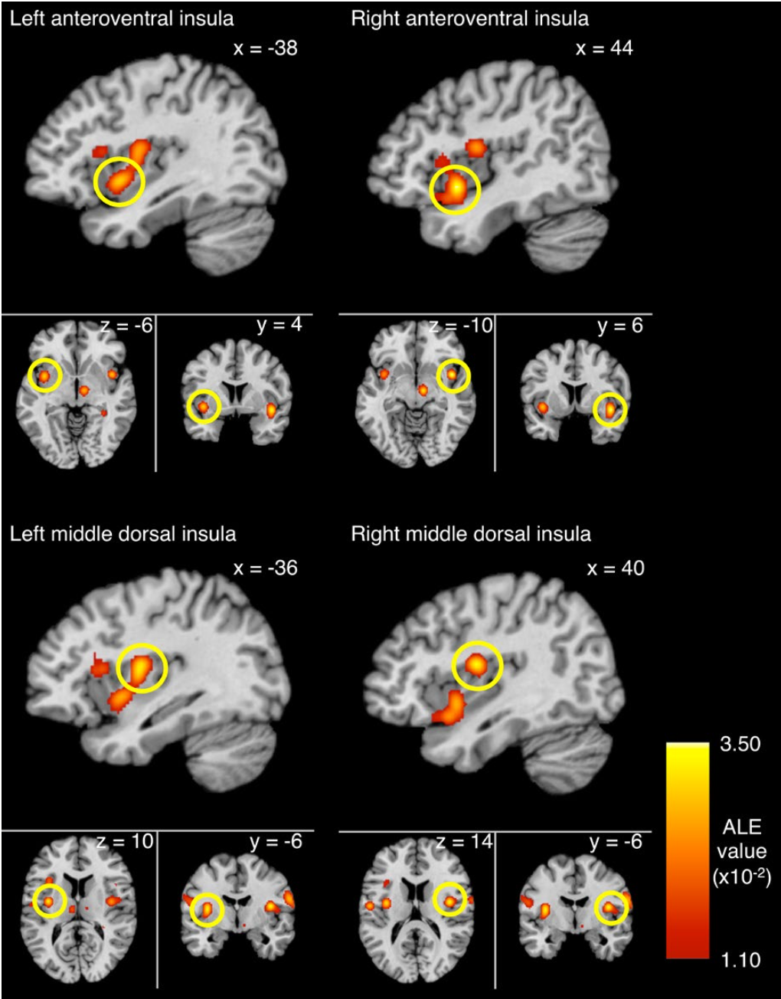
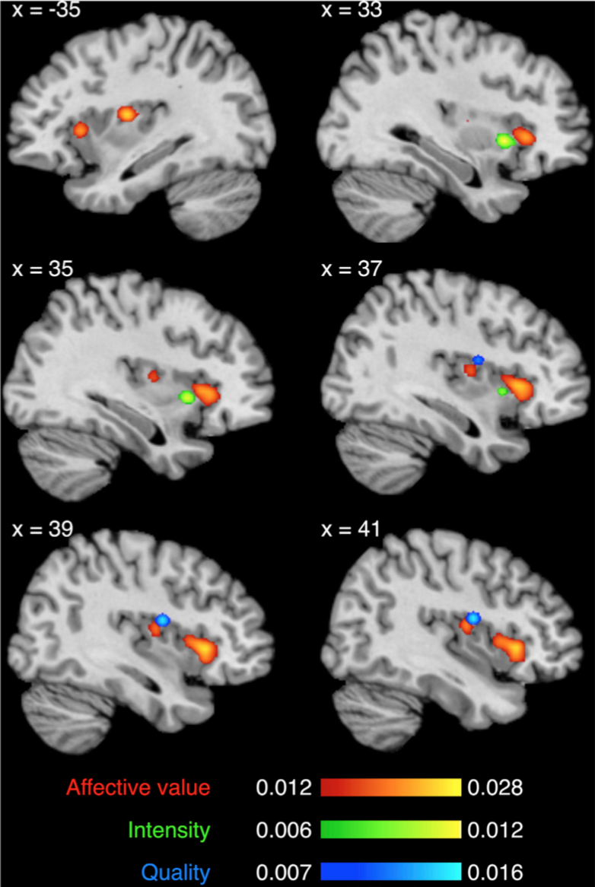
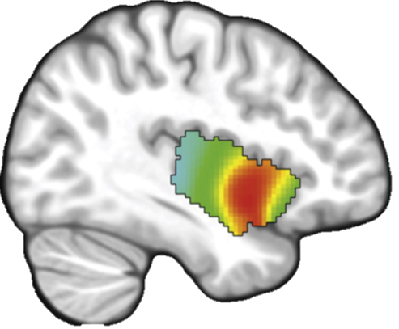
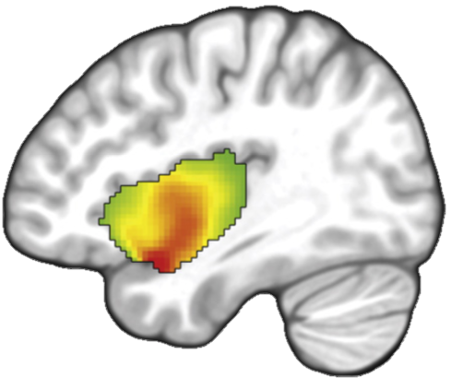
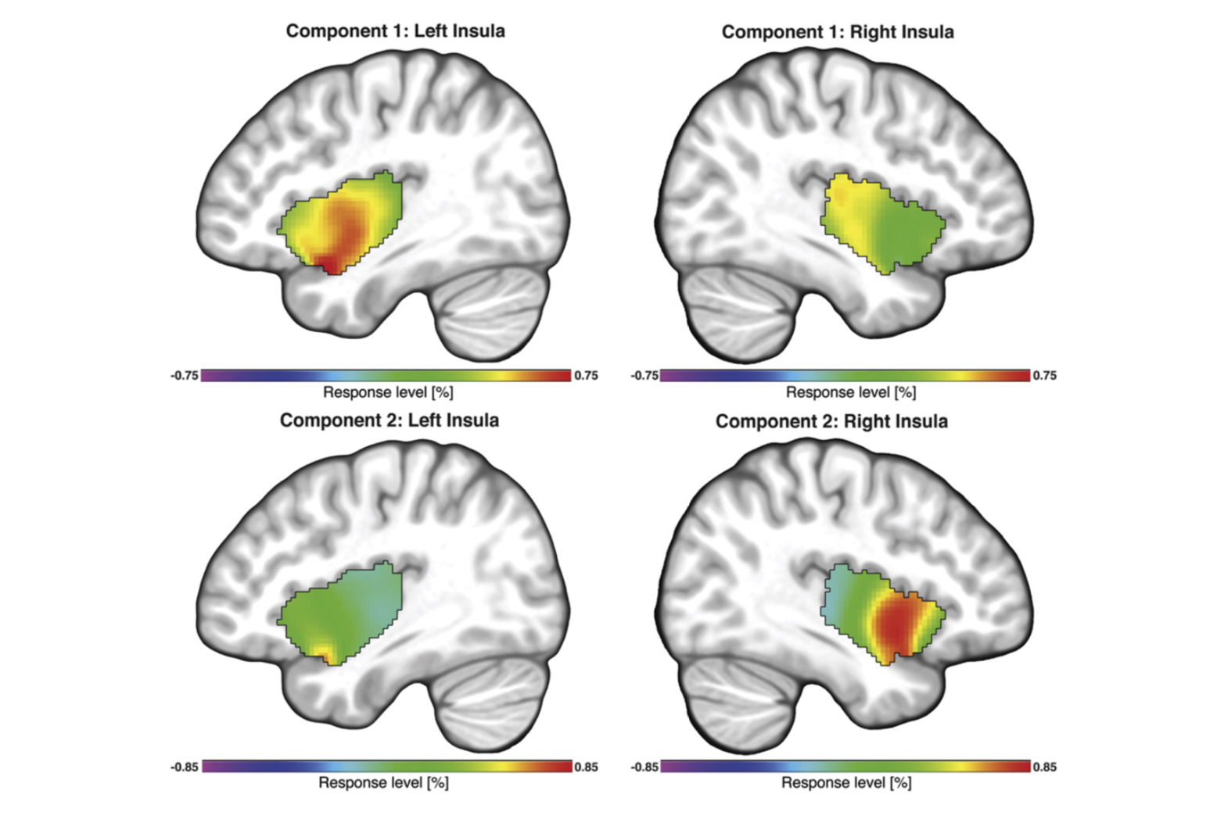
State of the Art : The perception of Taste in Human
fMRI studies of insular response to taste
Quality
Intensity
Affective valence
Affective valence
High
response
Low
response
Intensity
Dalemberg et al (2015) Hum. Brain Mapping
Quality
sweet
Yeung et al (2016) Brain and Behaviour.
Yeung et al (2018) NeuroImage
bitter
salt
sour
umami
No previous studies have analyzed the spatial distribution of the insular activation to taste intensity and/or quality
CO2
Prinster et al (2017) PlosOne

Slide 5
A novel and low-cost stimulation device
for gustatory fMRI experiment

Slide 6
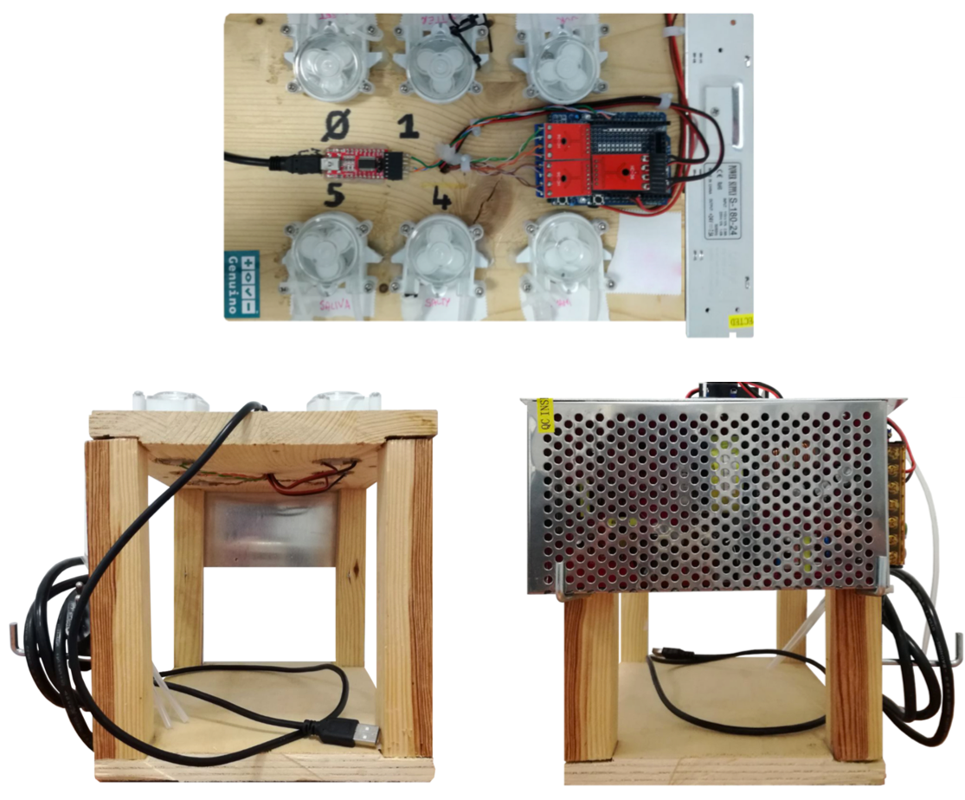
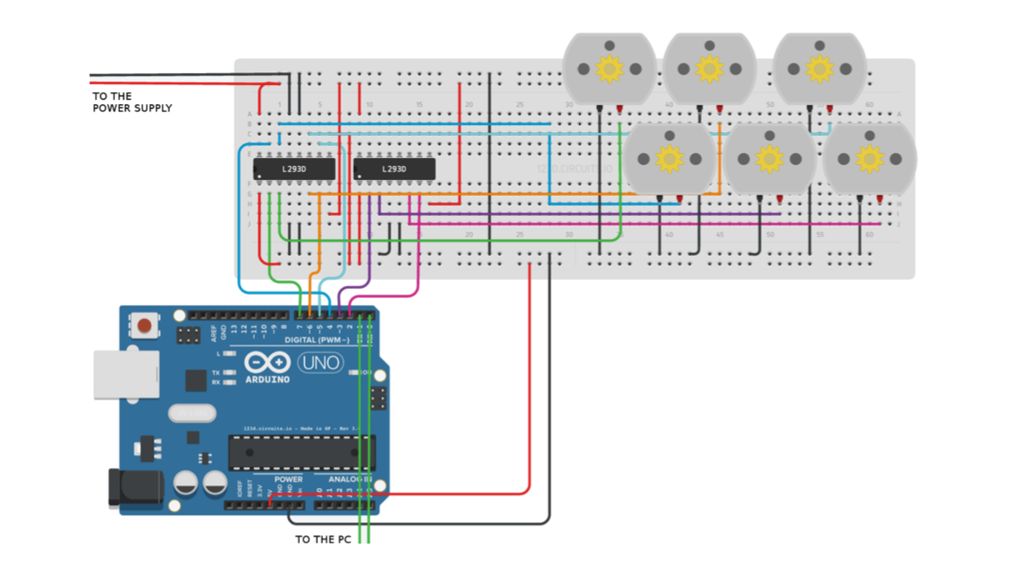
Chapter 1: A taste delivery system for gustatory fMRI
Architecture of the device
To the power
supply
Peristaltic micropumps
Arduino
microcontroller
To the stimulation computer
Canna et al (2018) Journal of Neuroscience Methods

Slide 7
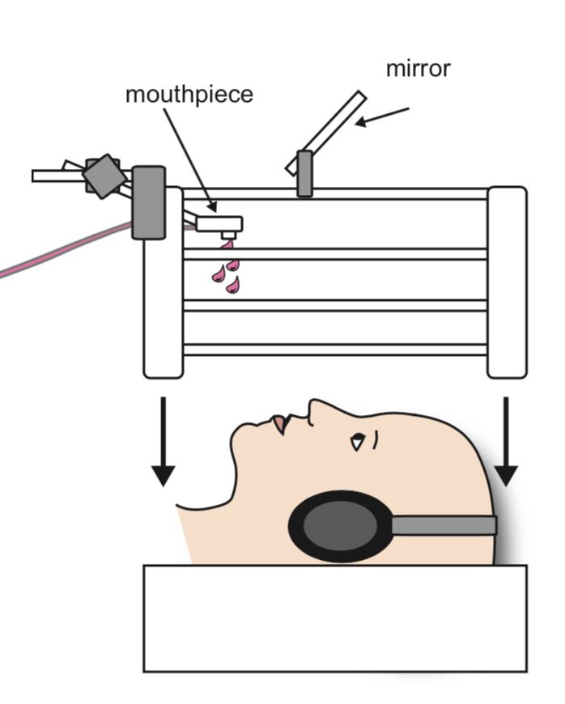

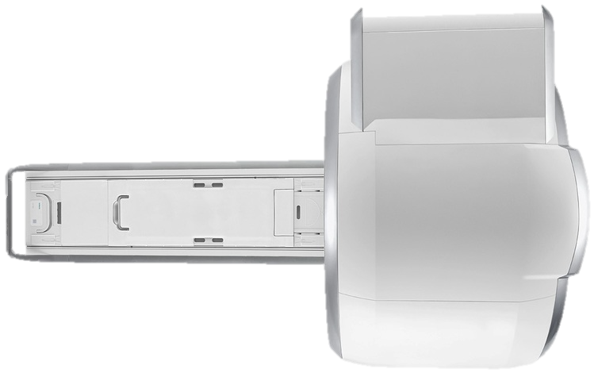
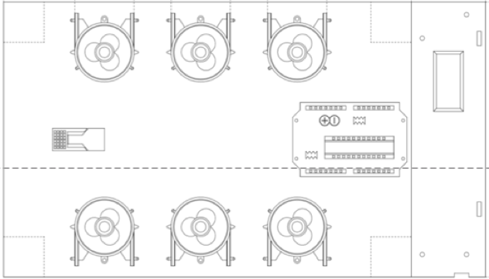
Chapter 1: A taste delivery system for gustatory fMRI
Experimental setup
Head coil
Mouthpiece
MR consolle
Head coil
Tubes
Stimulation computer
Mouthpiece
Gustometer
Consolle room
Scanning Area
Canna et al (2018) Journal of Neuroscience Methods

Slide 8
How does the insular cortex respond to taste intensity?

Slide 9
Chapter 2: Intensity related distribution of sweet and bitter
taste fMRI responses in the insular cortex
Laboratory session pre fMRI
13 subjects (25 ± 6 y) enrolled to select the taste concentrations.
Starting concentration setting:
Sweet (sucrose): 50mM, 60mM, 117mM, 245mM, 447mM, 658mM, 800mM, 976mM
Bitter (quinine hydrocloride): 0.05mM, 0.06mM, 0.12mM, 0.25mM, 0.50mM, 0.75mM, 1.00mM, 1.25mM
30 subjects (21 ± 3 y) enrolled to assess concentration specific
affective valence
Beidler model
Canna et al (2019) Human Brain Mapping (under review)

Slide 10
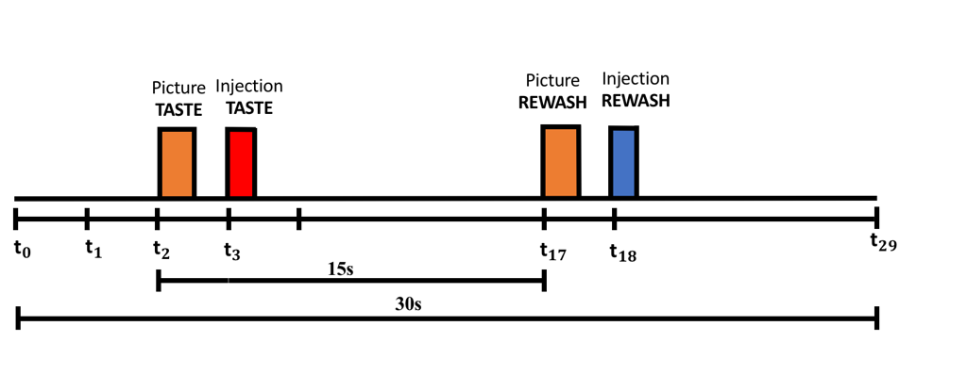
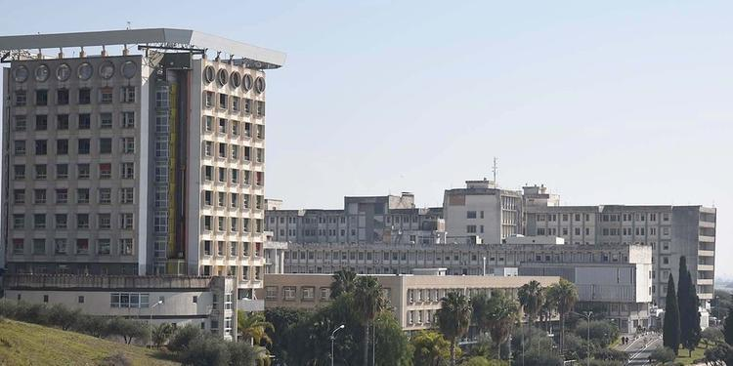
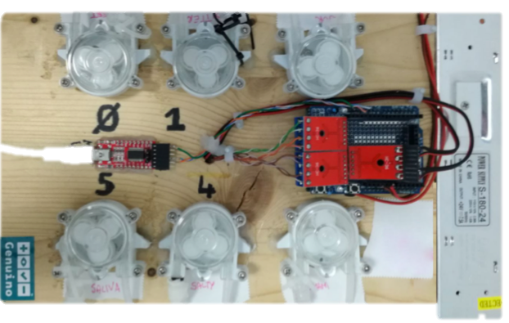
Chapter 2: Intensity related distribution of sweet and bitter
taste fMRI responses in the insular cortex
fMRI experiment
Demographic table:
# Subjects | Age (mean± SD) | BMI (mean± SD) | Sex
44 | 25 ± 4 | 23 ± 2.7 | 25 M, 19 F
3T Magnetom Skyra
(San Giovanni di Dio e Ruggi D’aragona)
MRI data acquisition:
High resolution anatomical acquisition, MPRAGE sequence 1 mm³ isotropic;
Multiband EPI sequence TR=1s, voxel size 2.5 mm³ isotropic
Stimulation protocol:
Canna et al (2019) Human Brain Mapping (under review)

Slide 11
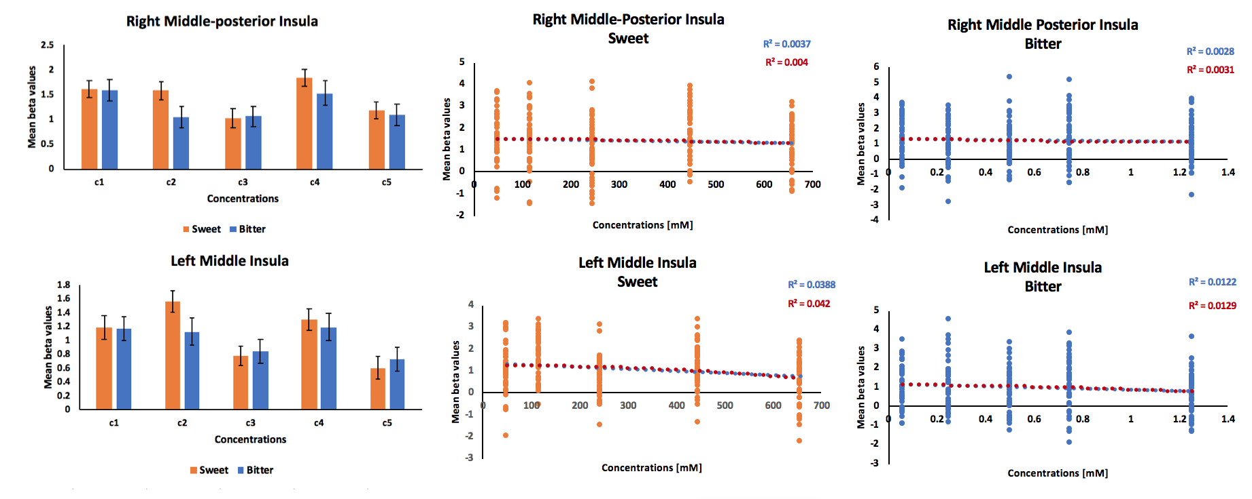
Chapter 2: Intensity related distribution of sweet and bitter
taste fMRI responses in the insular cortex
Results (1/2) : Insular activation to taste intensity
Right insula
Left insula
Differential effect of the concentrations
Canna et al (2019) Human Brain Mapping (under review)

Slide 12
Chapter 2: Intensity related distribution of sweet and bitter
taste fMRI responses in the insular cortex
Results (2/2) : spatial distribution taste
intensity in the bilateral insula
Canna et al (2019) Human Brain Mapping (under review)

Slide 13

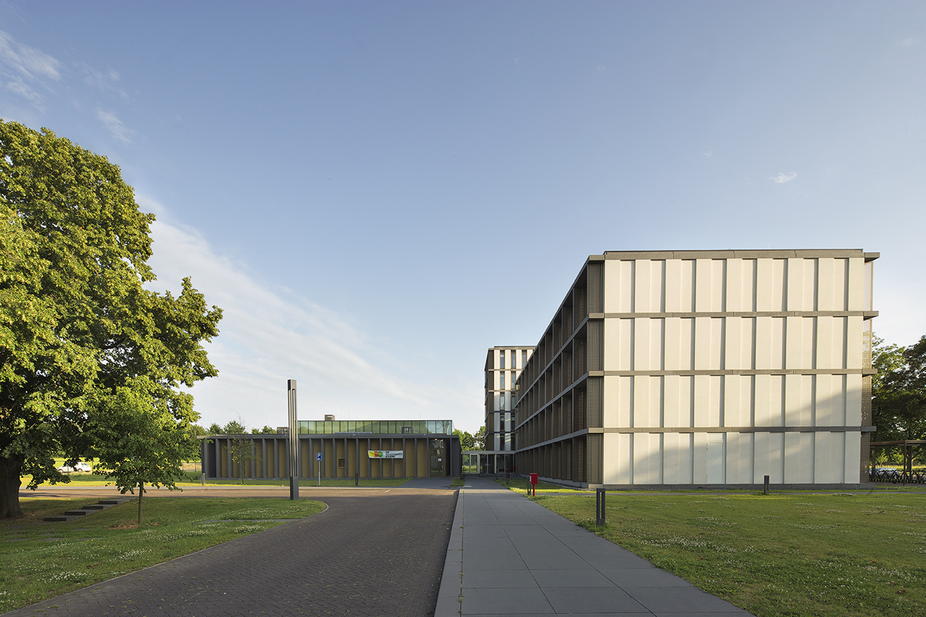

Chapter 3: Study of gustatory cortex using
Ultra High field (7T) fMRI
Is there a specialization for taste quality in Primary Gustatory Cortex?
A 7 Tesla fMRI study.

Slide 14
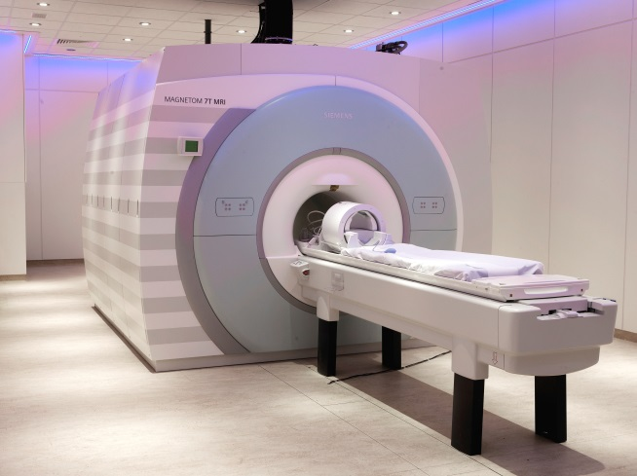
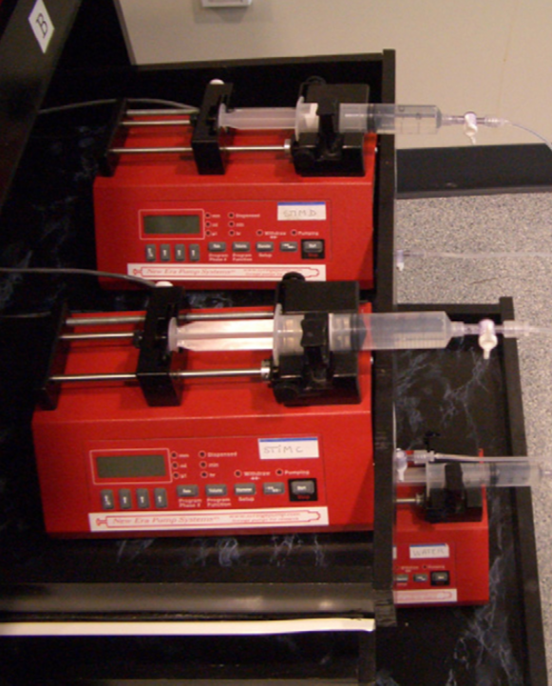
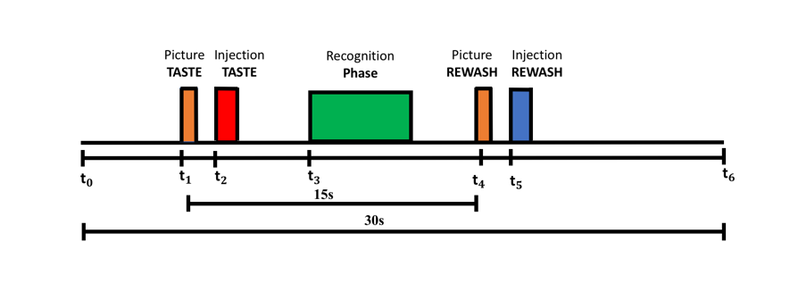
Chapter 3: Study of gustatory cortex using
Ultra High field (7T) fMRI
fMRI experiment
Demographic table
Magnetom 7T
(Scannexus facility, Maastricht University)
# Subjects | Age (mean± SD) | BMI (mean± SD) | Sex
8 | 27 ± 2 | 22 ± 2 | 4 M, 4 F
Gustometer
Stimulation protocol
Volume : 0.7ml for TASTES;
1.4ml for SALIVA;
Injection Time: 1.4s;
Pump FlowRate: 30 ml/min
High resolution anatomical acquisition, MPRAGE sequence 0.6 mm³ isotropic;
Multiband EPI sequence TR=1.5s, voxel size 1.2 mm³ isotropic
Canna et al (2019) Organization for Human Brain Mapping

Slide 15
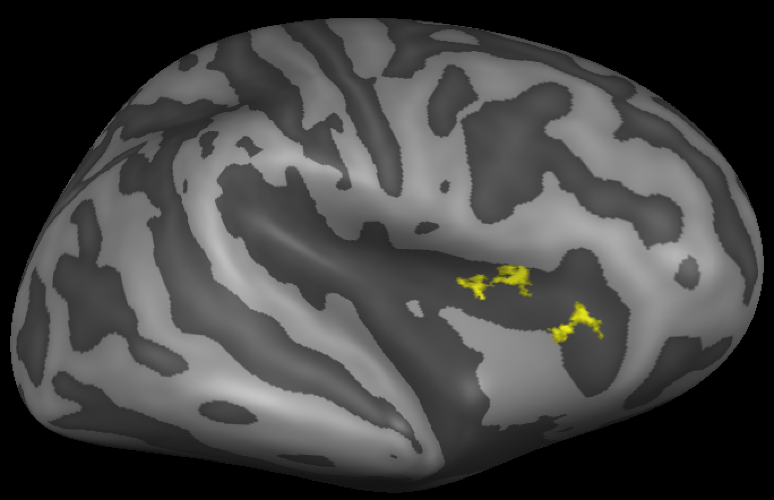
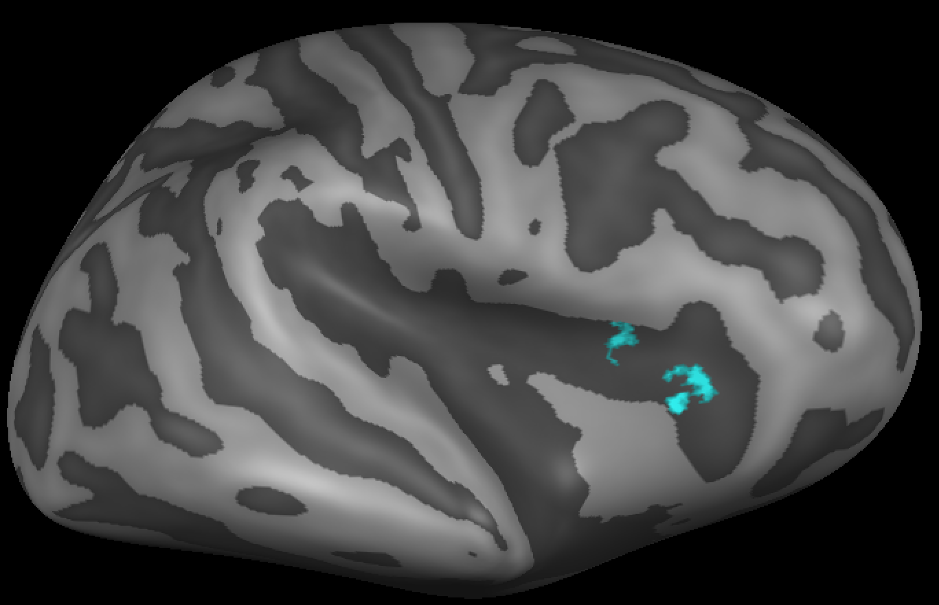
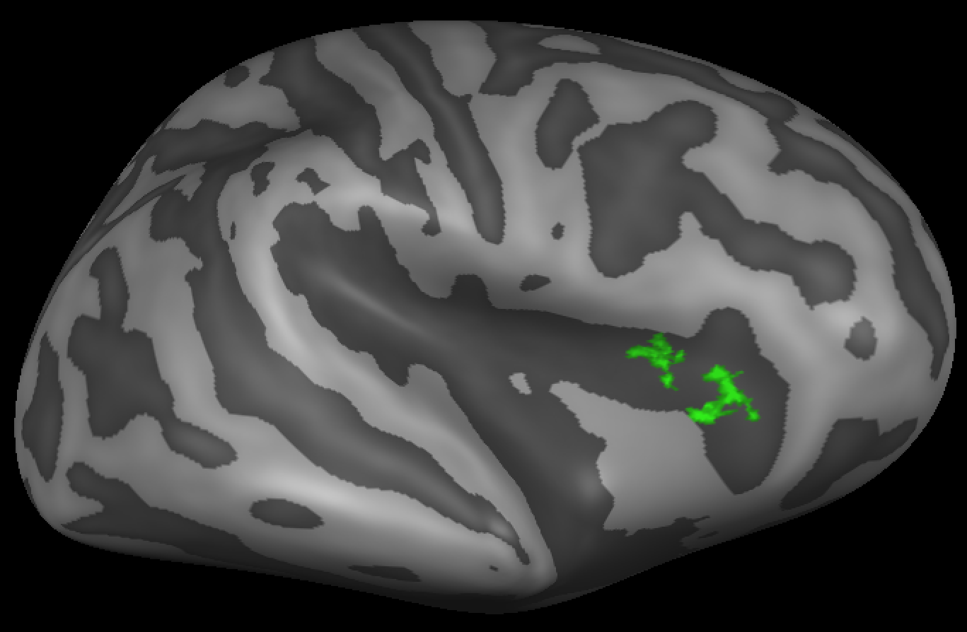
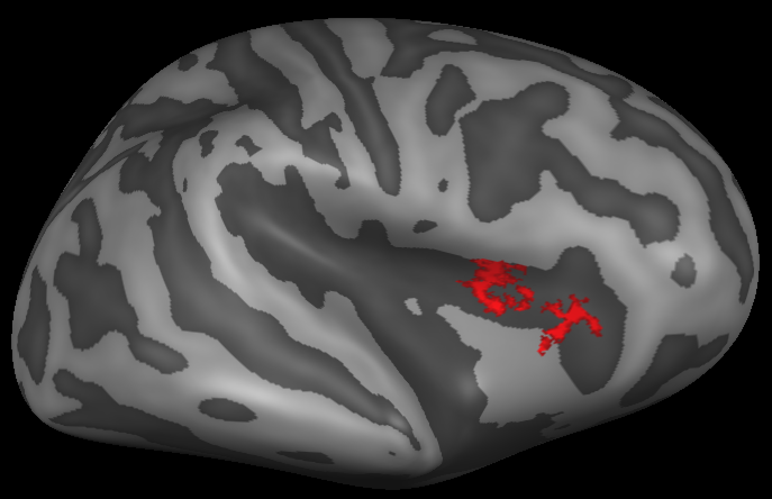
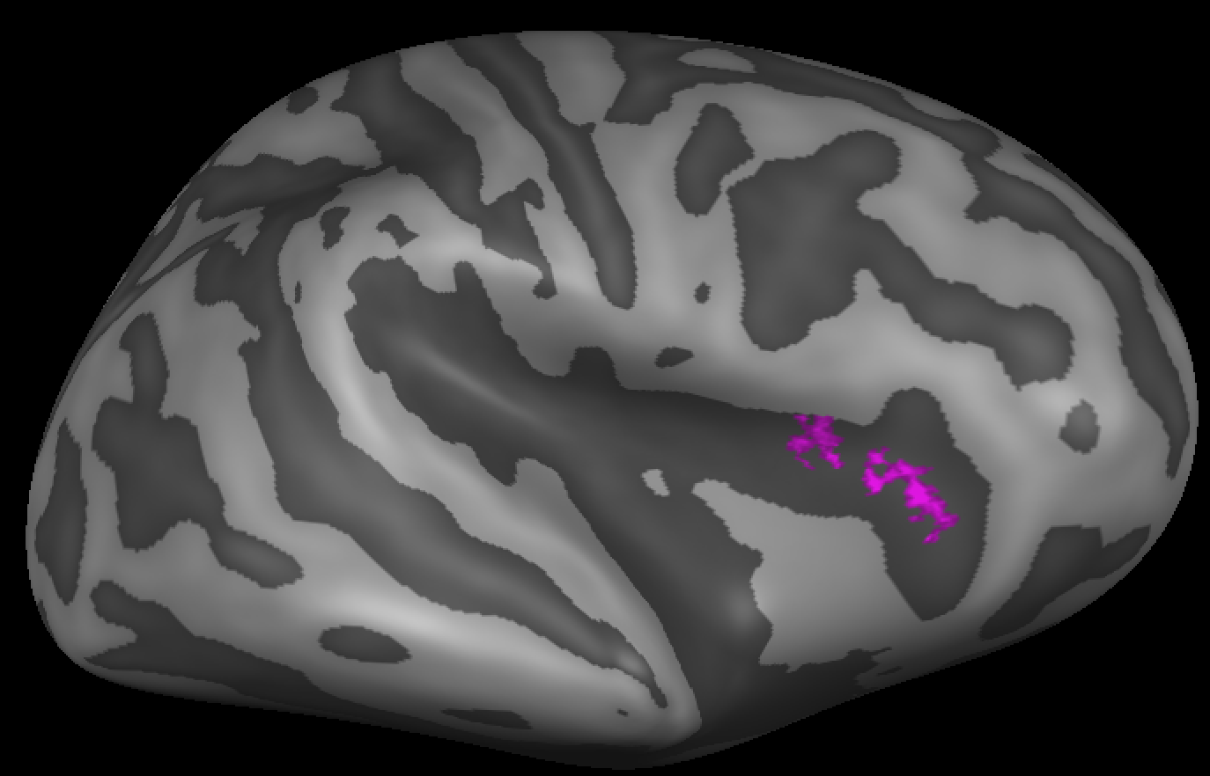
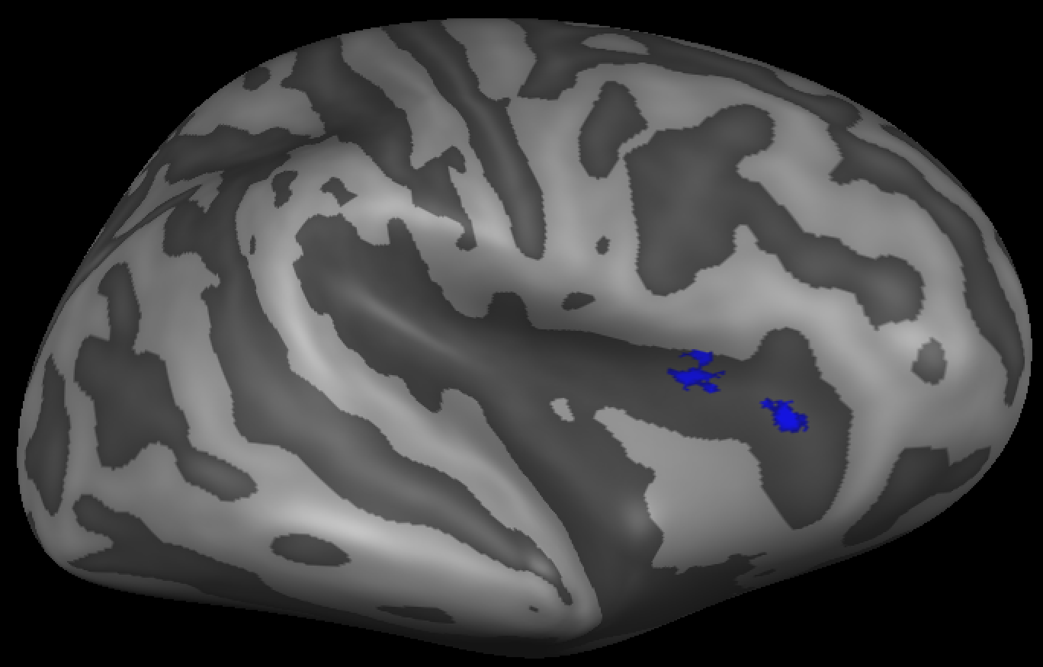
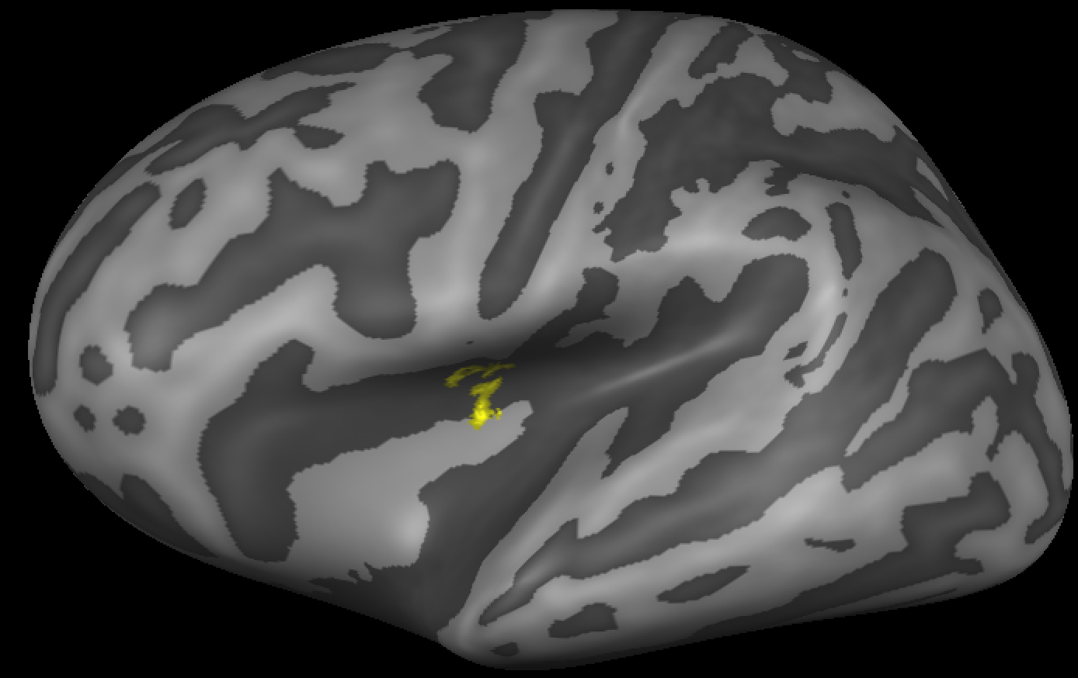
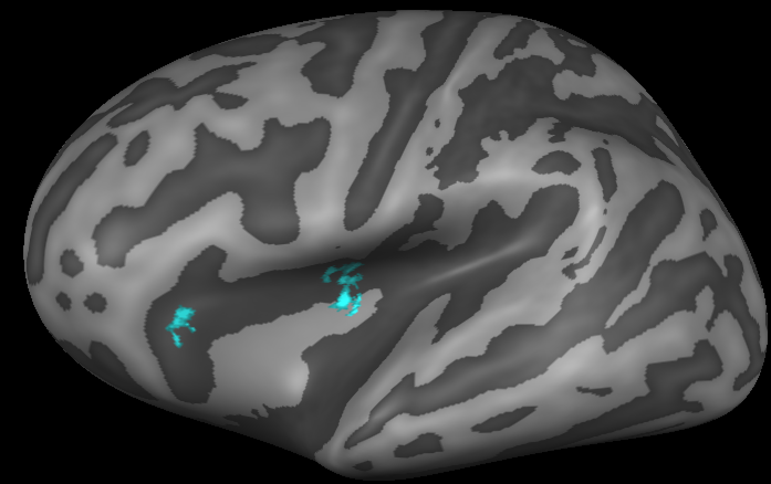
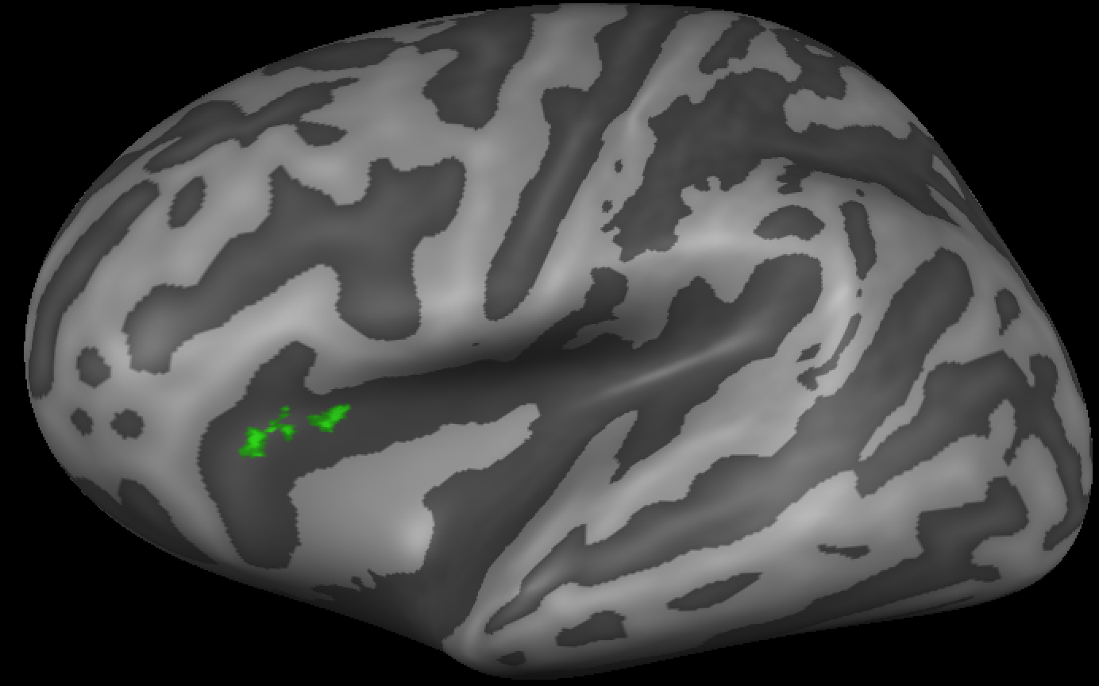





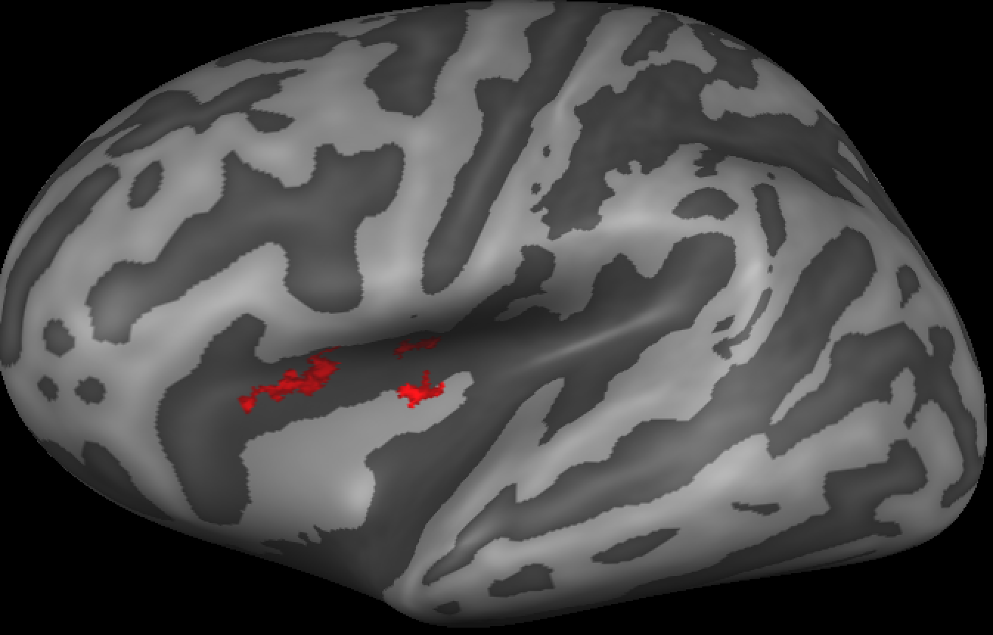
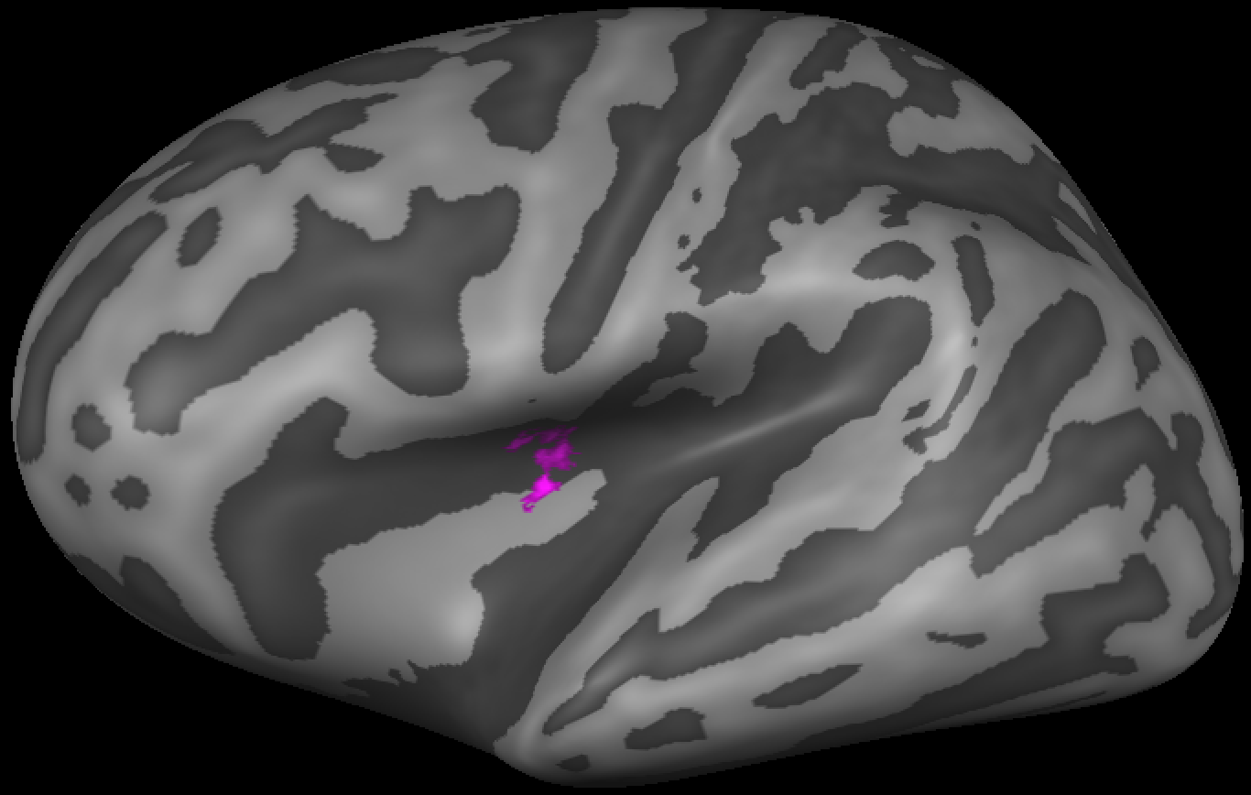
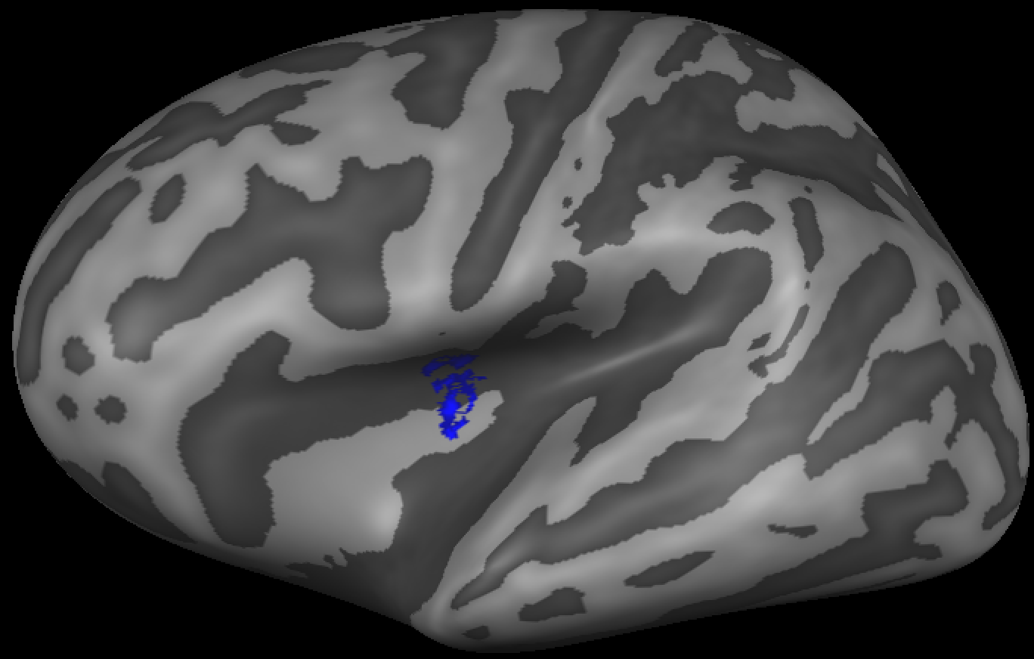
Chapter 3: Study of gustatory cortex using
Ultra High field (7T) fMRI
Results (1/3) : Group based activation maps
sweet
bitter
salty
Overlap
p = 0.001 | sweet | bitter | salty | sour | umami
sweet
bitter | 36.90 %
salty | 33.28 % | 39.36 %
sour | 37.35 % | 20.84 % | 24.84 %
umami | 29.94 % | 39.08 % | 41.74 % | 22.61 %
saliva | 32.19 % | 42.90 % | 35.81 % | 18.17 % | 41.67 %
Right
Insula
sour
umami
saliva
Overlap
p = 0.001 | sweet | bitter | salty | sour | umami
sweet
bitter | 49.39 %
salty | 0.00 % | 7.95 %
sour | 23.39 % | 25.68 % | 9.53 %
umami | 57.66 % | 49.91 % | 0.00 % | 22.91 %
saliva | 52.10 % | 51.01 % | 0.00 % | 24.70 % | 53.69 %
sweet
bitter
salty
Left
Insula
sour
umami
saliva
8.00
5.41
t(7)
p<0.001
Canna et al (2019) Organization for Human Brain Mapping

Slide 16
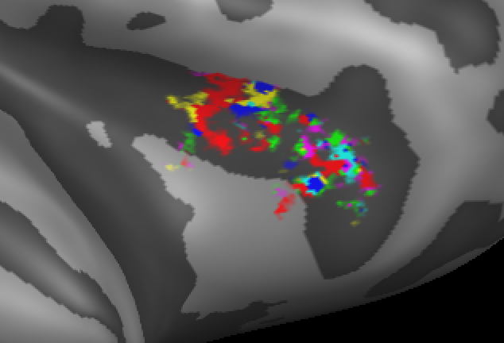
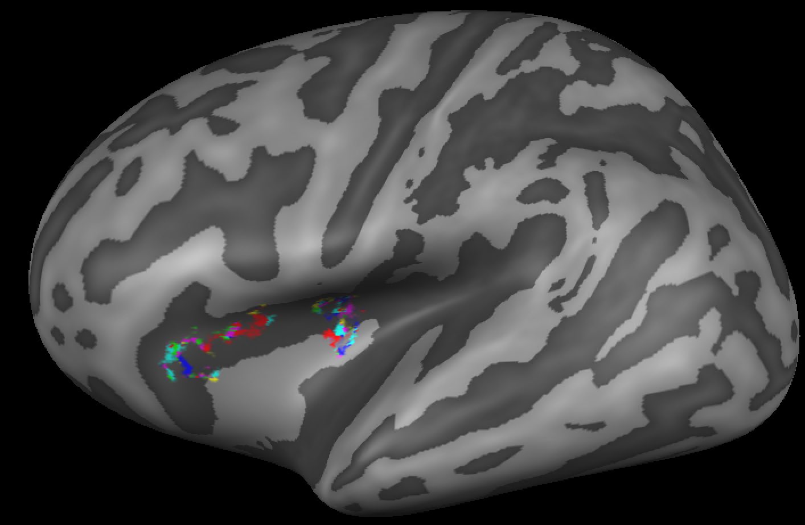
Chapter 3: Study of gustatory cortex using
Ultra High field (7T) fMRI
Results (2/3) : Spatial distribution of taste activations
t(7)
p<0.001
sweet
bitter
salt
sour
8.00
5.41
umami
Saliva
Right
Insula
Left
Insula
Canna et al (2019) Organization for Human Brain Mapping

Slide 17
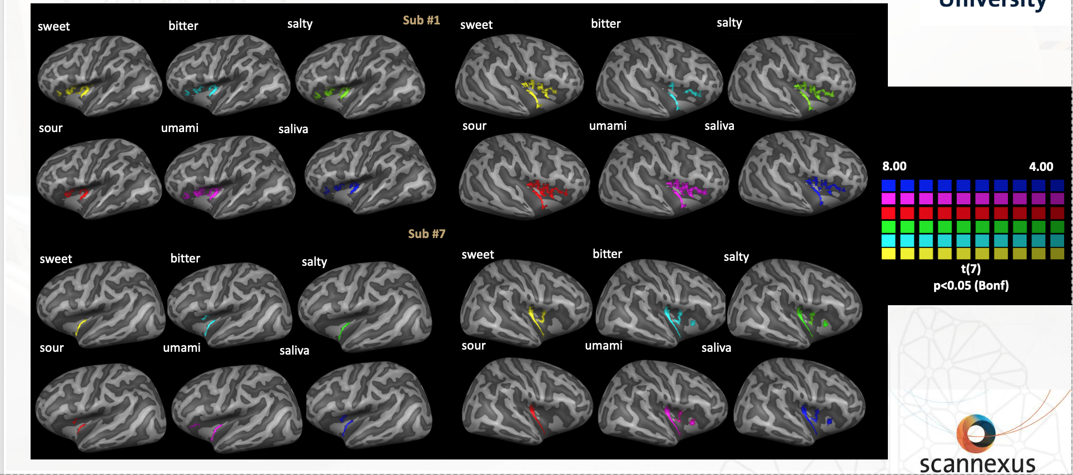
Chapter 3: Study of gustatory cortex using
Ultra High field (7T) fMRI
Results (3/3) : Single subject activation maps
Canna et al (2019) Organization for Human Brain Mapping

Slide 18
Are there alterations in the perception of pleasurable and aversive tastes in people affected by Anorexia Nervosa and Bulimia Nervosa?

Slide 19
Study of taste perception in eating disorders
MRI experiment
Study sample
MRI data acquisition:
 | Healthy Women | Anorexia Nervosa | Bulimia Nervosa
Number | 20 | 20 | 20
Age | 26.1 ± 3.5 | 25.2 ± 6.4 | 26.7 ± 7.6
BMI | 19.5 ± 1.9 | 15.3 ± 1.7 | 18.6 ± 1.8
Disease Duration |  | 7.6 ± 6.7 | 8.8 ± 6.1
1) EPI single-shot acquisition, TR=2000ms, voxel size 2,87 x 2,87 mm;
Taste stimulation:
- Sweet (sucrose) 292mM;
- Bitter (quinine hydrocloride) 0.05mM;
2) a T1-weighted 3D TFE SENSE volume slice thickness 1.2 mm;
3) resting-state fMRI sequence, TR=1700ms, voxel size 3,2 x 3,2 x 4 mm.
4 ) diffusion-weighted sequence TR=9300ms, voxel size 2x2x2 mm, B-value 0-1000 mm/sec², 16 directions.
Inclusion criteria:
current diagnosis of AN or BN, according to DSM-5;
female gender;
age > 18;
willingness to cooperate in the experimental procedures and to sign a written informed consent;
no psycho- pharmacological treatment during the preceding 6 weeks;
no history of neurological or medical diseases and drug abuse/dependence;
no history of head trauma with loss of consciousness;
no concomitant comorbid Axis I psychiatric disorder
Monteleone et al (2017) J Psychiatr Res.

Slide 20
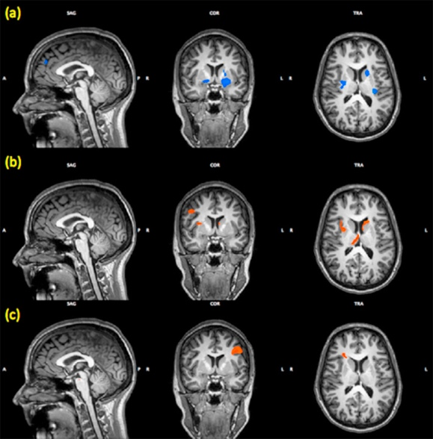
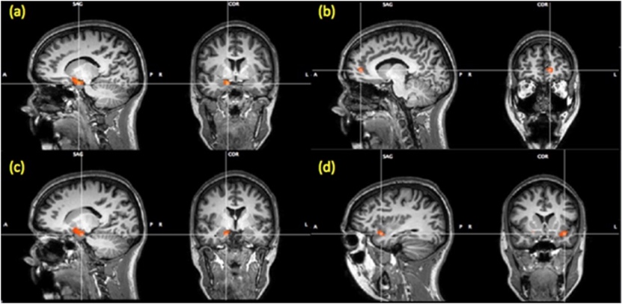
Study of taste perception in eating disorders
fMRI data results
Main activation in the cortical-striatal taste pathway
Sweet vs Bitter
HC
Single taste analysis
bitter
HC vs AN
R-Amygdala
L-ACC
AN
sweet
R-Amygdala
L-Insula
BN
HC vs BN
sweet
Monteleone et al (2017) J Psychiatr Res.

Slide 21
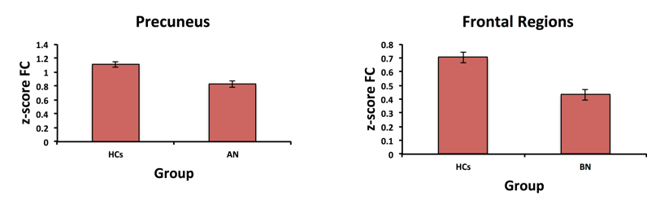
Study of taste perception in eating disorders
Interhemispheric functional connectivity
Voxel mirror homotopic connectivity measures
Correlation VMHC and DTI fractional anysotropy
HC vs AN
HC vs BN
Genu of CC
VS
Insula
**
**
**
**
Canna et al (2016) European Journal of Neuroscience

Slide 22
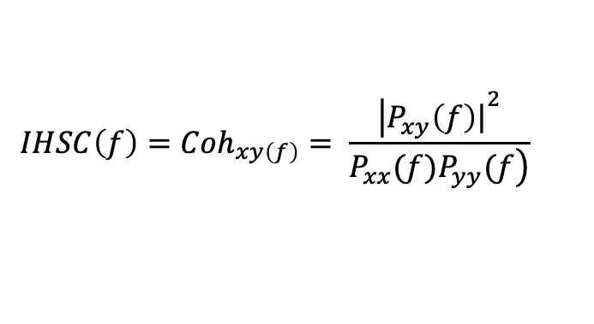
Study of taste perception in eating disorders
Interhemispheric functional connectivity
‘Slow-4’ = 0.027–0.073 Hz
‘Slow-5’ = 0.01– 0.027Hz
Frequency analysis
Interhemispheric spatial coherence
Main effects of regional spectral coherence
$$IHSC\left(f\right)=Coh_{xy\left(f\right)}= \frac{{\left|P_{xy}\left.\left(f\right)\right|\right.}^{2}}{\left.P_{xx}(f)P_{yy}(f\right)}$$
HC vs AN
Group and Frequency
Frequency trend of mean coherence signals
HC vs AN
HC vs AN
Group and Frequency
HC vs BN
Group
HC vs BN
Canna et al (2016) European Journal of Neuroscience

Slide 23

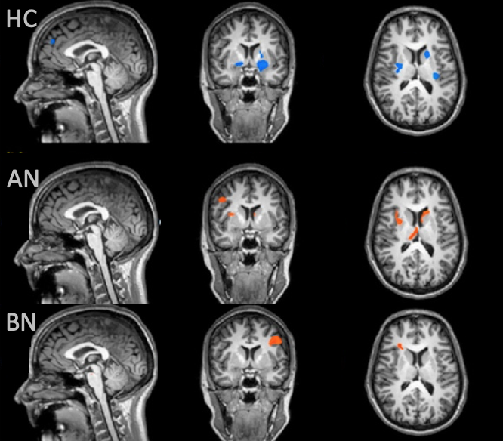
Conclusions
- The insular response to taste intensity is distributed in the bilateral insula according to a supero-inferior and to an antero-posterior spatial gradients. The clusters in the middle insula process the taste intensity according to a non-linear profile.
- The results obtained by the ultra-high field do not support the idea of a chemotopic organization of the insular activation to basic taste qualities
The gustatory pathway is altered in people affected by eating disorders, in several regions belong to the corticostriatal taste pathway. The inter-hemispheric connectivity is altered in people affected by eating disorders and the observed differences remain significant in the frequency domain, especially in the ranges of the “Slow-4” and “Slow-5” frequencies’ ranges, suggesting the VMHC and the IHSC as new measures to investigate the pathophysiology of EDs.

Slide 24
Thanks for your kind attention
Acknowledgements
Prof. Fabrizio Esposito
Prof. Francesco Di Salle
Prof. Renzo Manara
Prof. Palmiero Monteleone
Dott.ssa Anna Prinster
Dott.ssa Elena Cantone
Prof. Anne Roefs
Prof. Elia Formisano
Dott.ssa Sara Ponticorvo
Dott. Andrea Gerardo Russo
Prof. Silvia Mangia
Prof. Shalom Michaeli
Institutions:
University of Salerno,
Department of Medicine,
surgery and Dentistry
“Scuola Medica Salernitana”
University of Maastricth,
Deparment of Cognitive Neuroscience
Grant:
ERCPN 159_15_12_2015_S6
Publications
Canna A., Prinster A. , Fratello M. , Puglia L., Magliulo M., Cantone E., Pirozzi M. A., Di Salle F. , Esposito F. (2018) : A low-cost open-architecture taste delivery system for gustatory fMRI and BCI experiments. Journal of Neuroscience Methods.
Canna A., Prinster A., Cantone E., Ponticorvo S., Russo A.G., Di Salle F., Esposito F.(2019): “Intensity related distribution of sweet and bitter taste fMRI responses in the insular cortex. Human Brain Mapping” (Under Review).
Canna A., Russo A.G., Ponticorvo S., Manara R., Pepino A., Sansone M., Di Salle F., Esposito F. (2018):“Automated search of control points in surface-based morphometry” NeuroImage.
Canna A., Ponticorvo S., Russo A.G, Manara R., Di Salle F., Saponiero R., Callaghan M., Weiskopf N., Esposito F. (2018): “A Group-level Comparison of Volumetric and Combined Volumetric-Surface Normalization for Whole Brain Analyses of Myelin and Iron Maps”. Magnetic Resonance Imaging.
Canna A., Prinster A., Monteleone A. M., Cantone E., Monteleone P., Volpe U., Maj M., Di Salle F., Esposito F. (2016): “Interhemispheric Functional Connectivity in Anorexia and Bulimia Nervosa.” European Journal of Neuroscience.
Monteleone A. M., Monteleone P., Esposito F., Prinster A., Volpe U., Cantone E., Pellegrino F., Canna A., Milano W., Aiello M., Di Salle F., Maj M. (2017): “Altered processing of rewarding and aversive basic taste stimuli in symptomatic women with anorexia nervosa and bulimia nervosa: An fMRI study.” J Psychiatr Res.
Monteleone A. M., Monteleone P., Esposito F., Prinster A., Ruzzi V., Canna A., Aiello M., Di Salle F., Maj M. (2017): “The effects of childhood maltreatment on brain structure in adults with eating disorders.” World J Biol Psychiatry.

